Slide 1

Final Presentation 16th Jan -19
Group 3 Christoffer ParkKILA – Filip Andersson – MoHAMMED ABU SAmaan Erika Weilander – Sai Vijay Vemasani - Zaid Abed Jaser - Osamah Al-Braichi – Matko butkovic

Slide 2
What was our project now again?
Our client Daniel Sundmark is a representative from MDH
Client is responsible for the management of several concurrent projects at Mälardalen University.
Goal is to refactor and enhance the existing Desktop application to more user-friendly Web application with better GUI.
Received an existing database.

Slide 3
.. and how did it go?
Developed a React-based web application.
Requirements having high priority have been met.
Modifications in connection between front-end and back-end are to made.

Slide 4
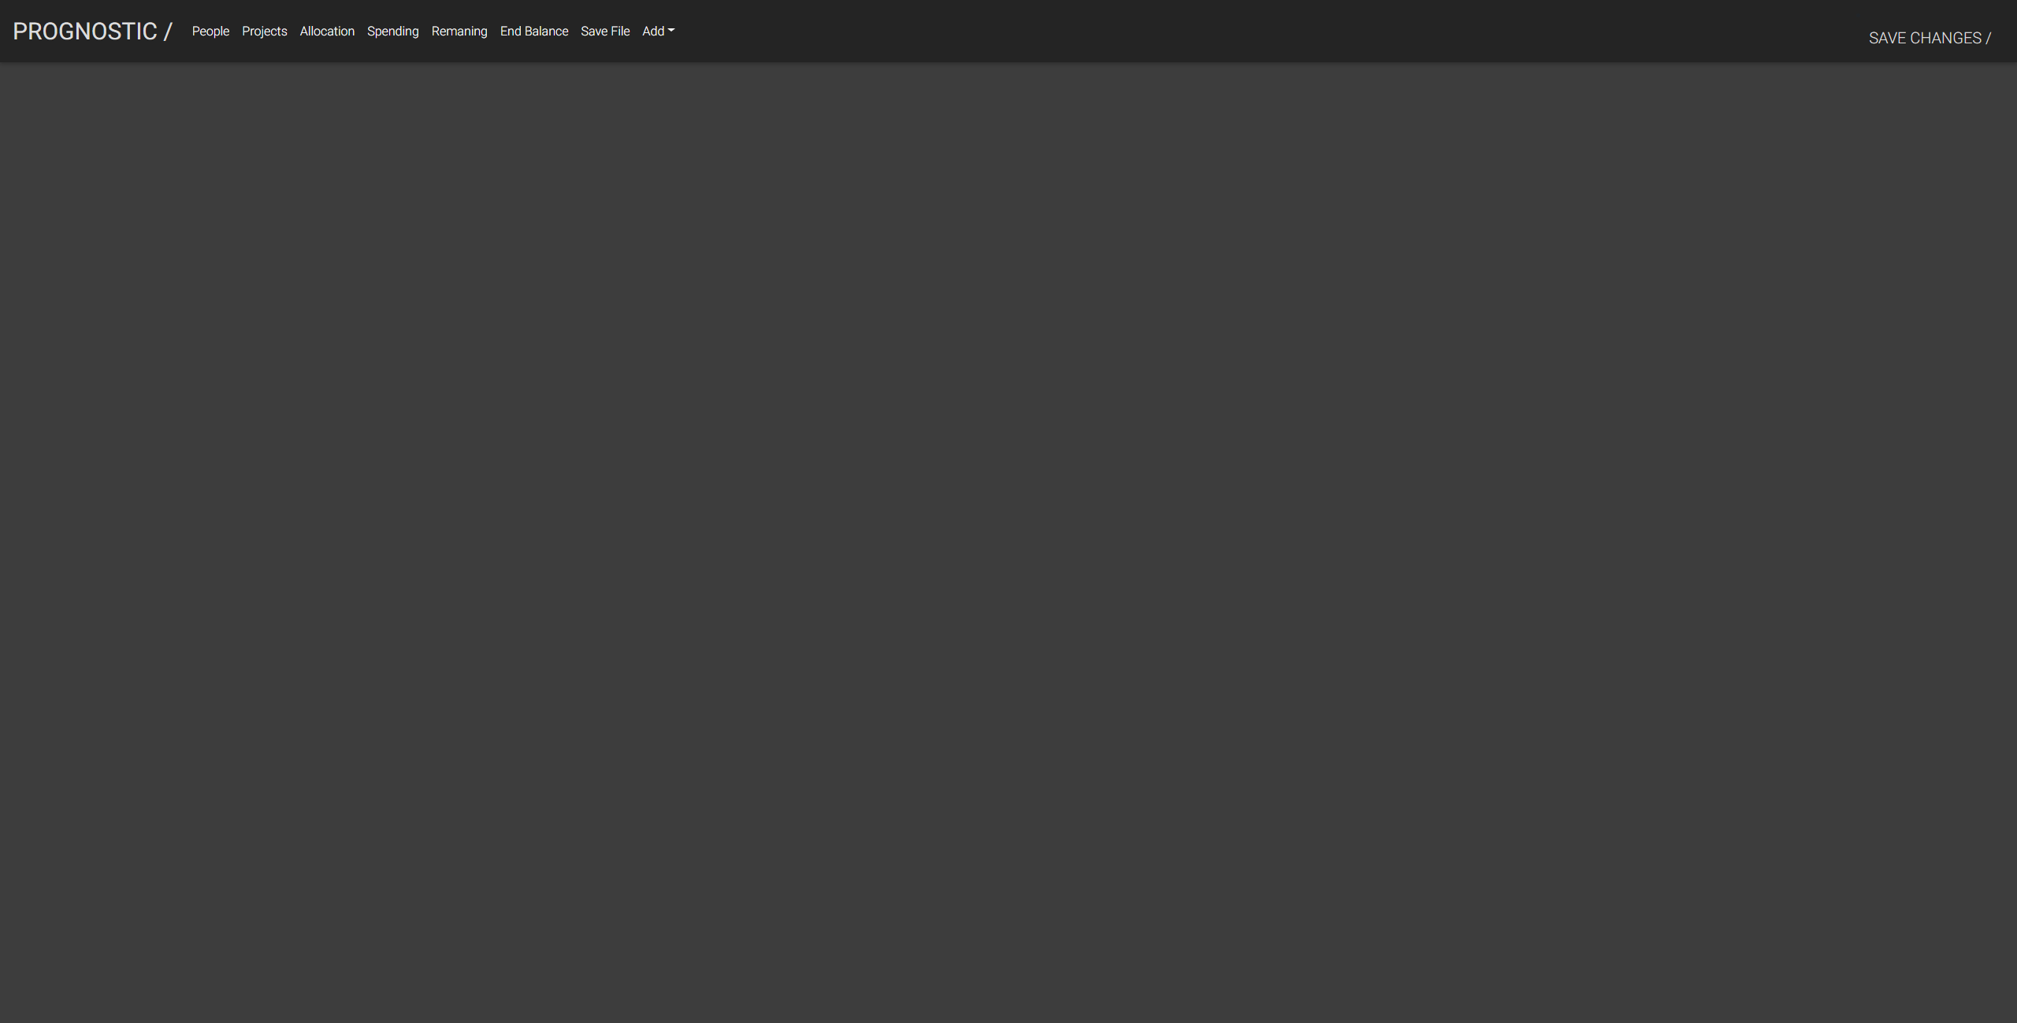
LIVE DEMO TIME!
Please turn off your phones and other electronic EQUIPMENT

Slide 5
What got left behind?
Starting from the list of requirements, the only thing not implemented is ID number 16. It would be a nice feature having a view which displays all the allocations of a certain project. However, due to lack of time there was no chance of implementing this. Another thing is one feature which was not intendedly in the original plan was to have. In the navigation bar, it was supposedly to be a button with a drop-down menu containing quick-adds for adding either people or project without having to enter the tabs. This idea was also dropped due to lack of time.

Slide 6
Did our client change their mind?
Since the day the project started, the client has been very clear in their wishes. On top of that, the project is based on developing a better user interface for an already existing application. This resulting in that there never were any major changes from the client along the way. However, one thing worth mentioning - after the start of the project the client mentioned that they wanted to be able to drag the allocation vertically to change the allocation of person. In addition to this, they wanted some color or any other visuality to show when allocation is over-allocated.

Slide 7
Time plan
The only proper time plan we had was the regular deliverables such as the documents
Worked in sprints where we planned each weeks tasks together and then worked on them individually

Slide 8
Changes in organization
Started out with 4 people on back-end and 4 people on front-end. As back-end development grew smaller, 3 people moved to the front-end.
The front-end people from back-end worked on the connections between the front-end and back-end

Slide 9
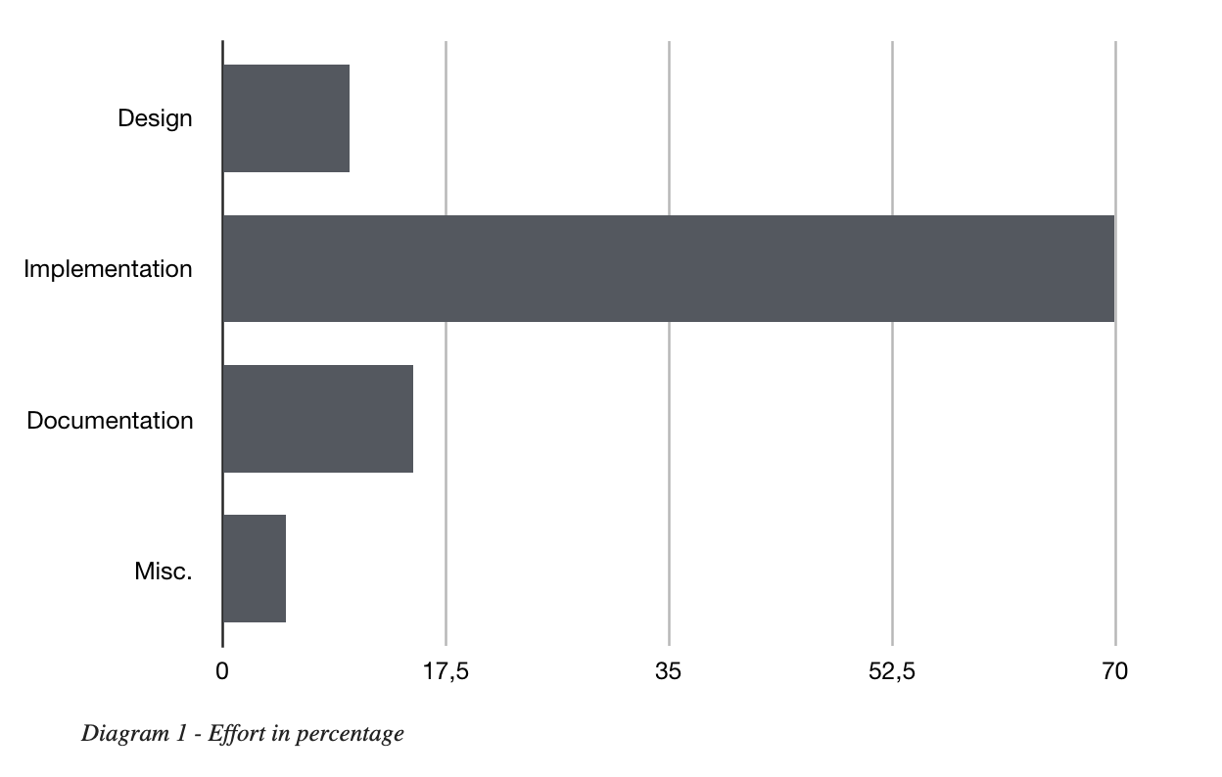
Effort amongst activities
We tried setting expected effort in beginning, ended up concluding it was too difficult at that stage.
Chart based on trello-cards and what has been put in time report

Slide 10
Experiences from the project
Working as a group
Putting previous knowledge to test
Working in sprints
Working with a real client
Become experienced with useful tools

Slide 11
What could have been improved
Distribution of work
Stricter on deadlines
More work done before Christmas

Slide 12
Questions?

Slide 14
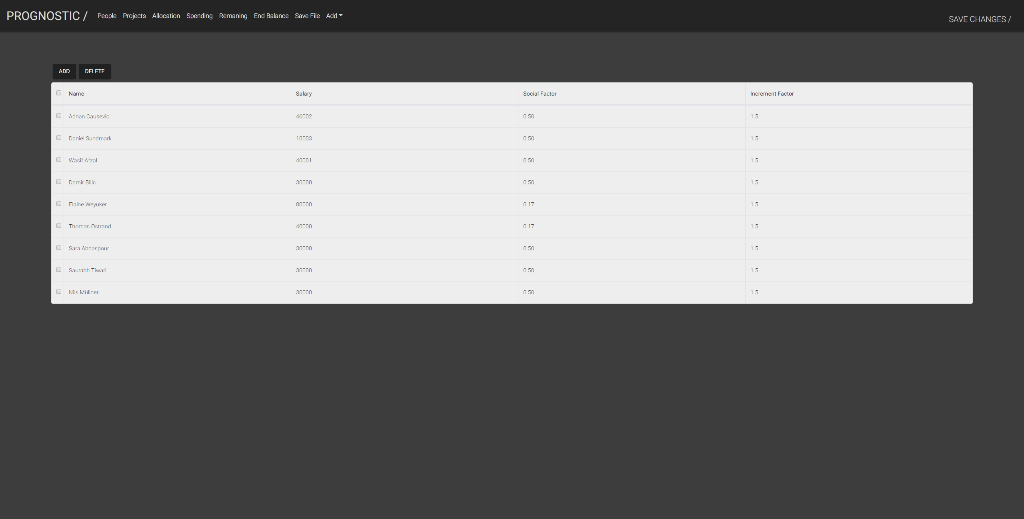

Slide 15
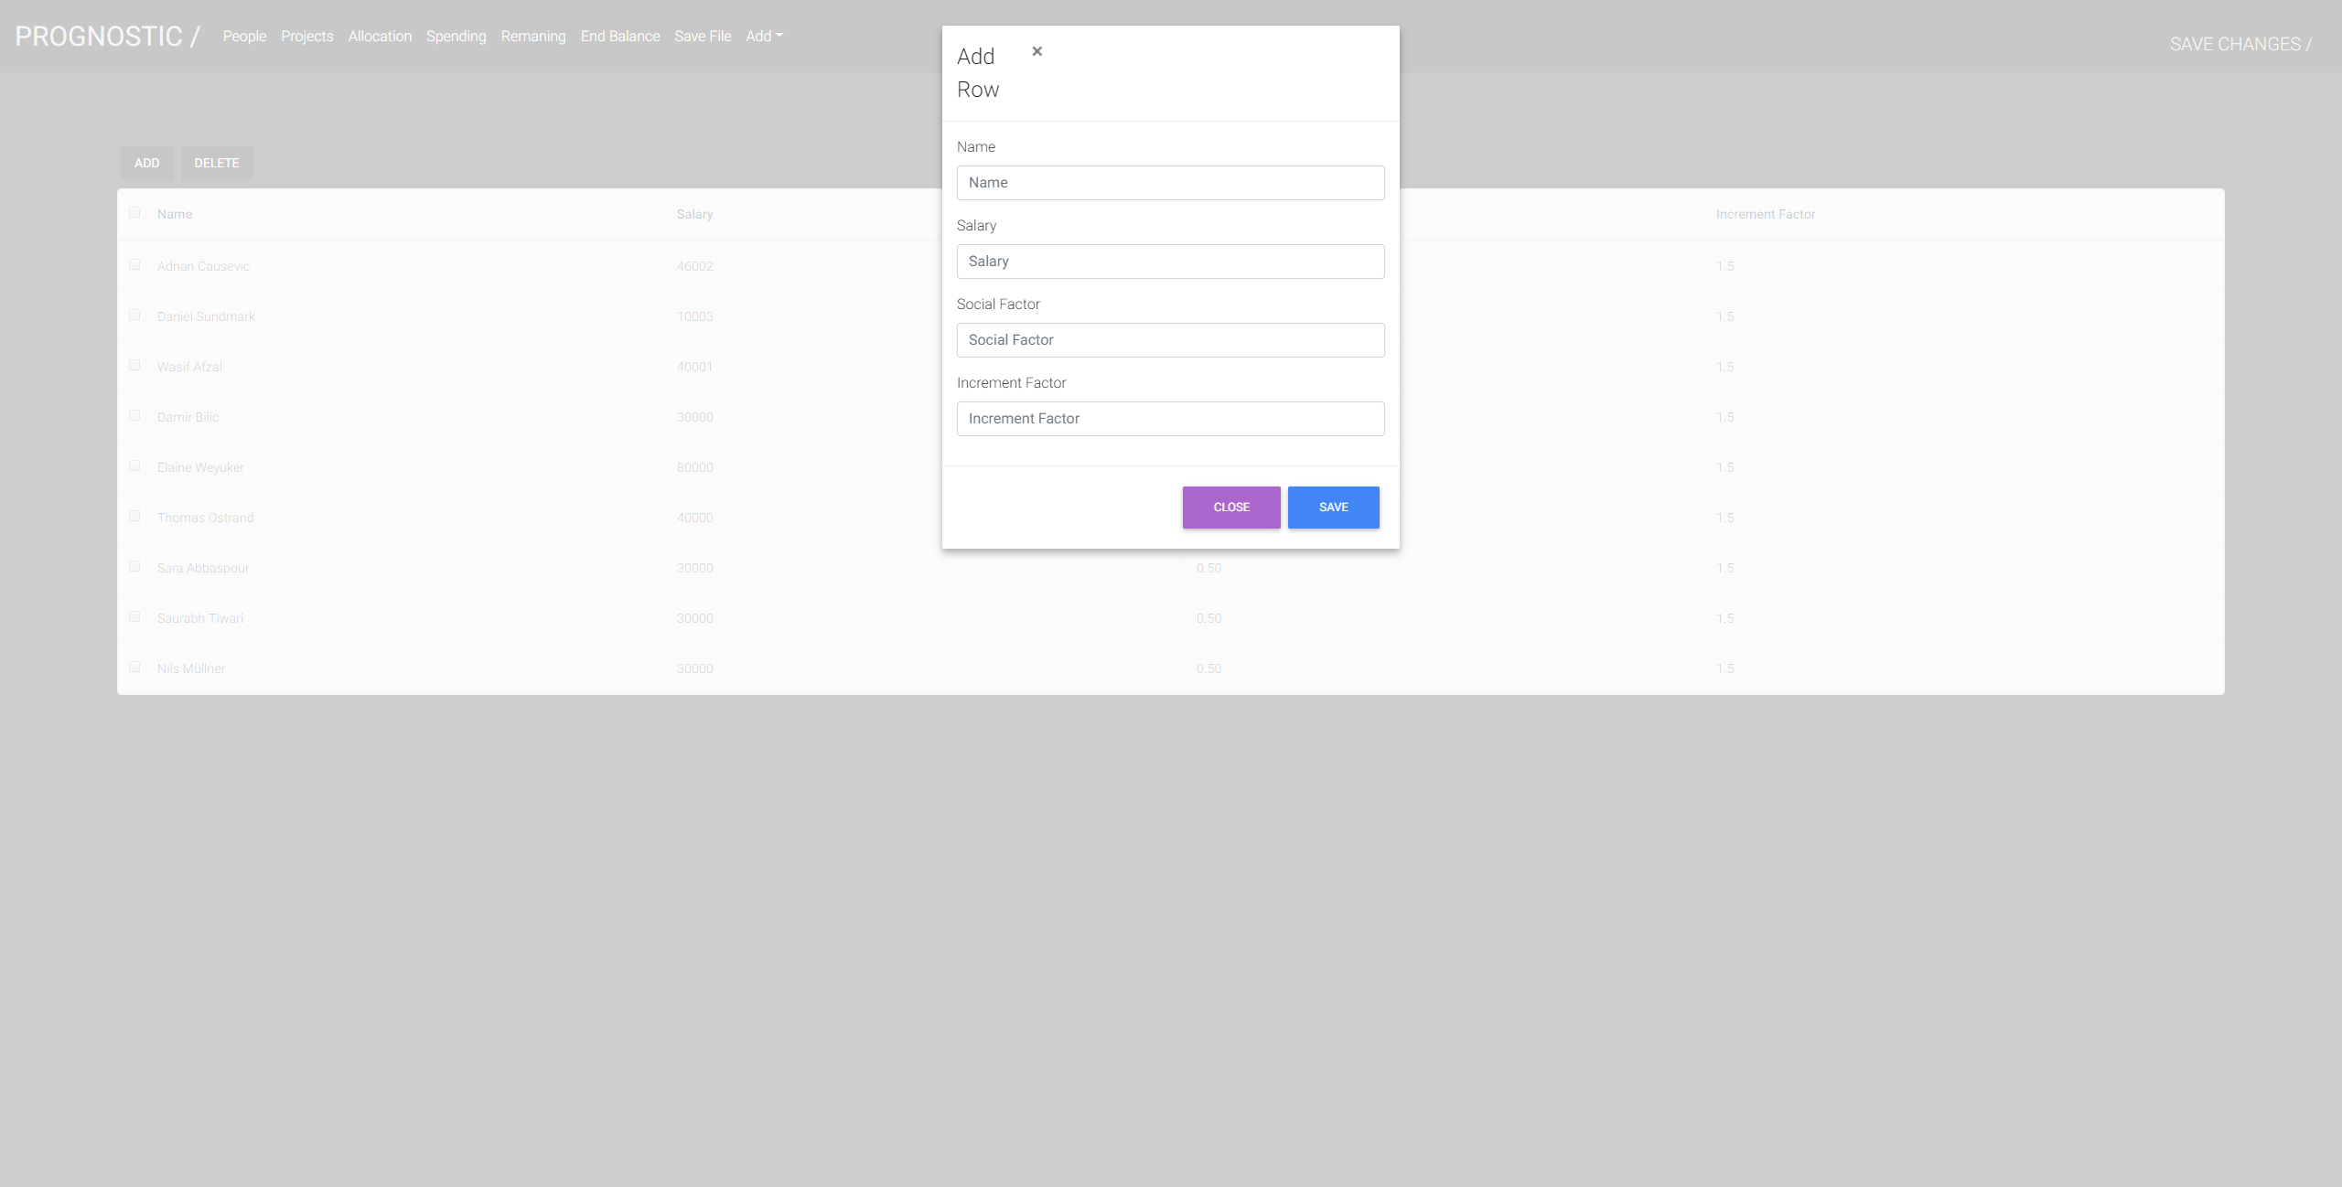

Slide 16
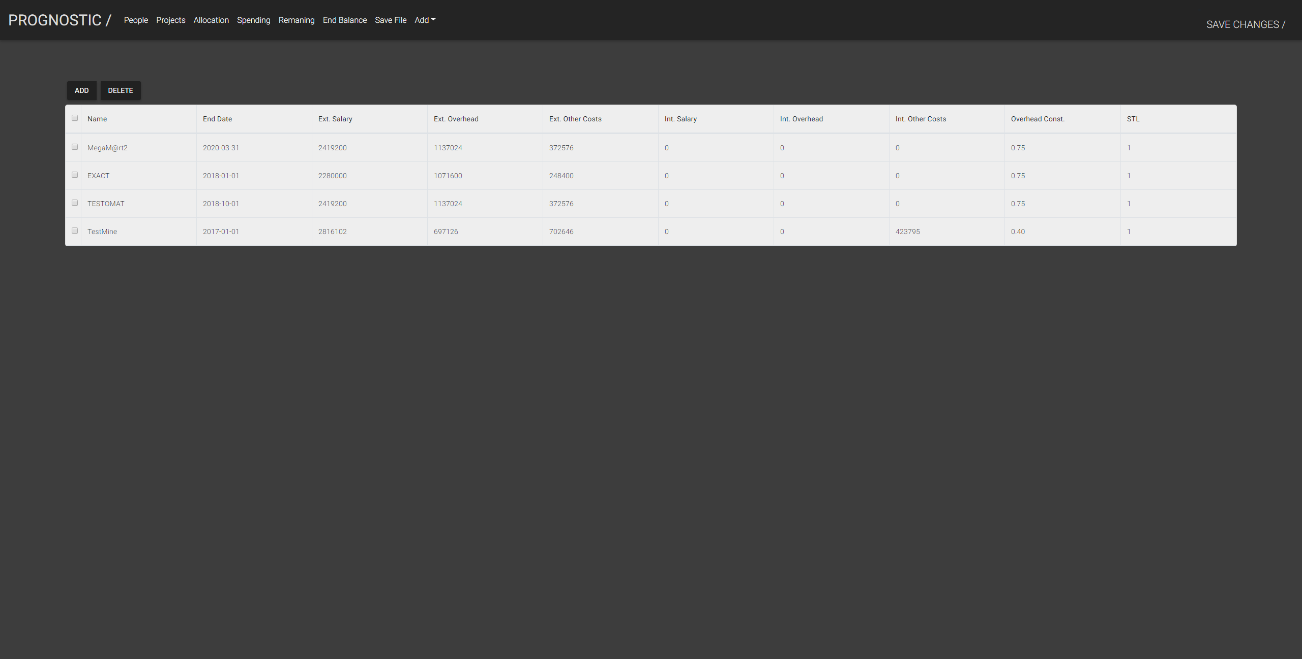

Slide 17
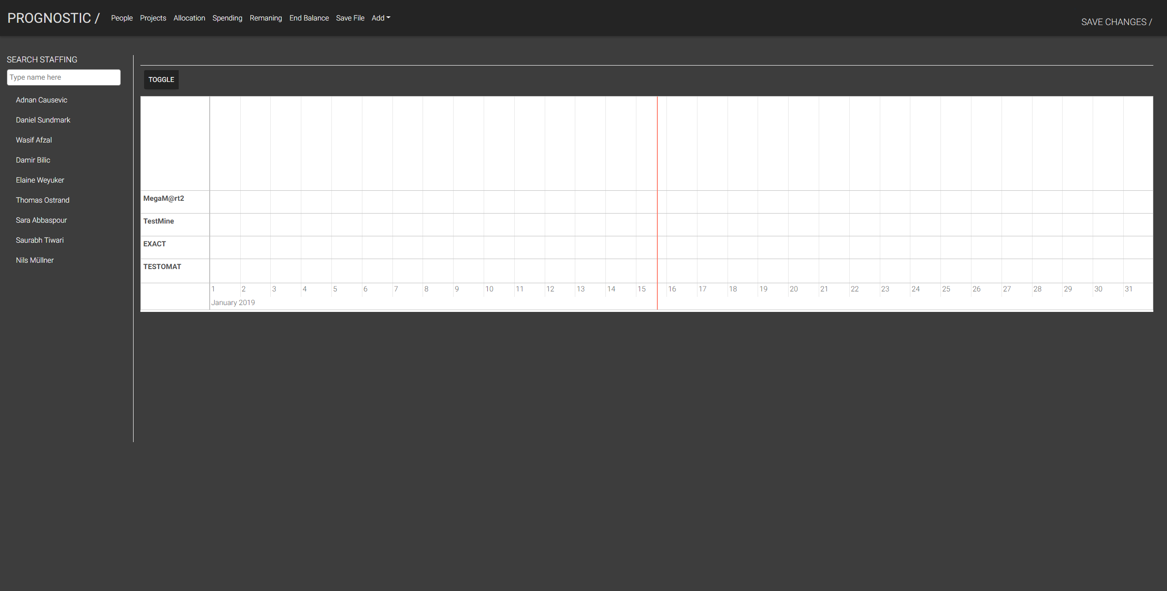

Slide 18
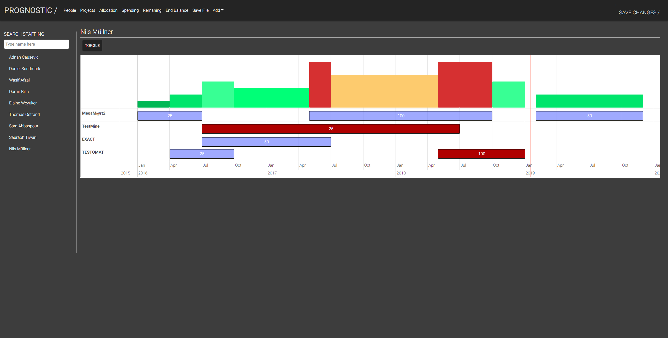

Slide 19
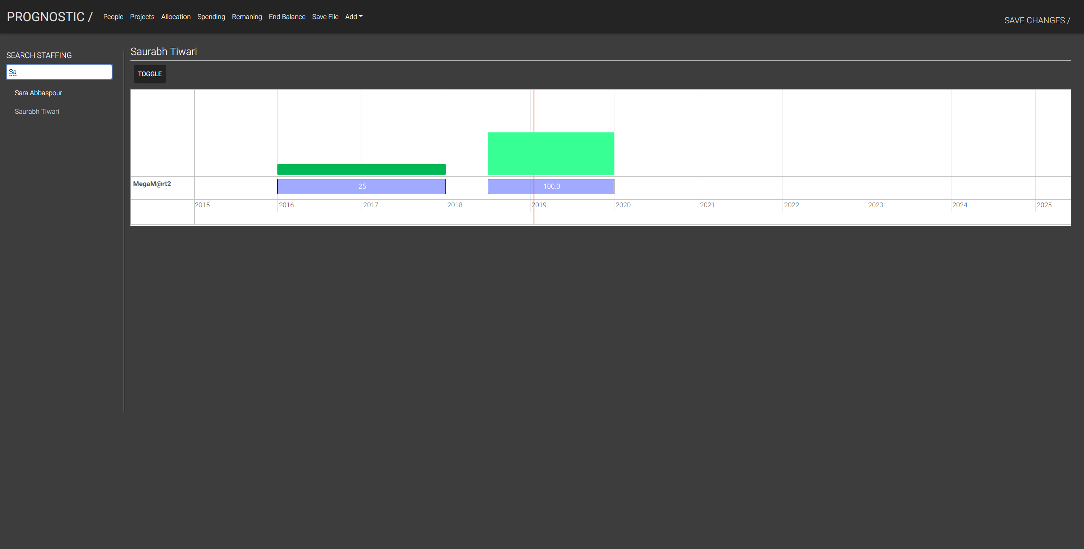

Slide 20
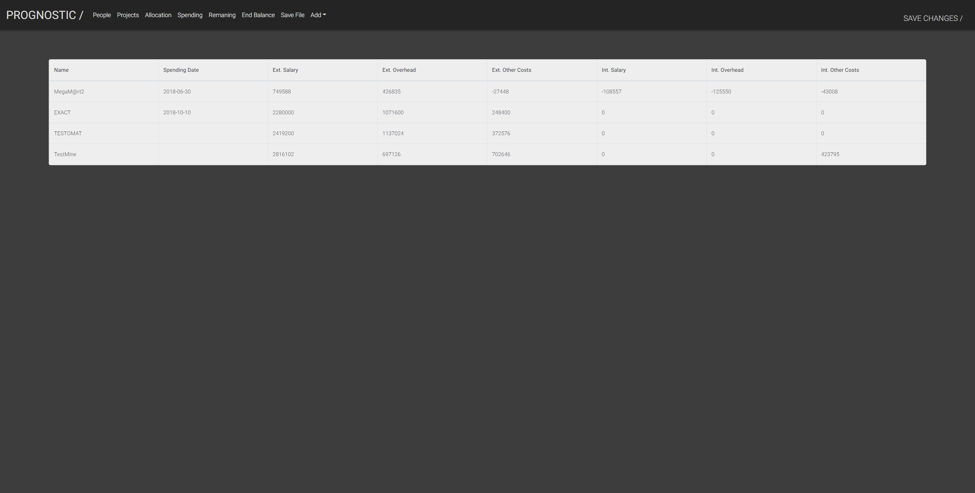

Slide 21
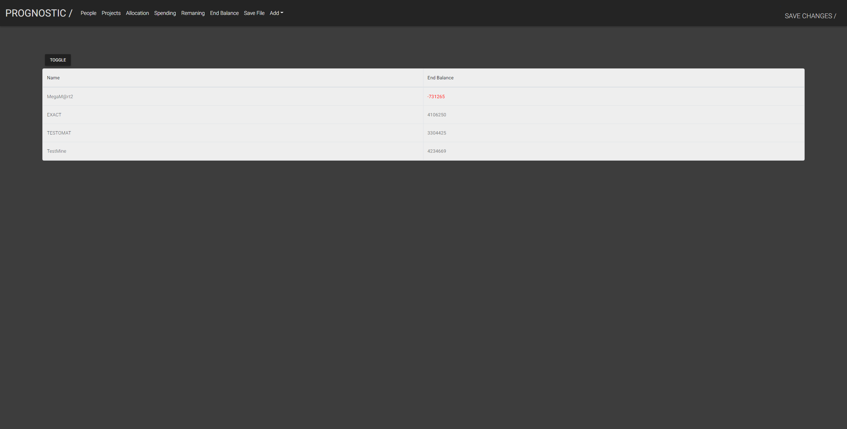

Slide 22


